Slide 1

Introduction to RNA-seq
bioDSC workshop
2 & 4 March 2026

Slide 2
bioDSC/carpentries introductions

Slide 3
Refresher 1: hypothesis testing
In an RNA-seq experiment, you will measure the expression of 1000s of genes
Essentially, we try to answer the question ”Is Gene x differentially expressed and higher in treatment y than treatment z?” many times

Slide 4
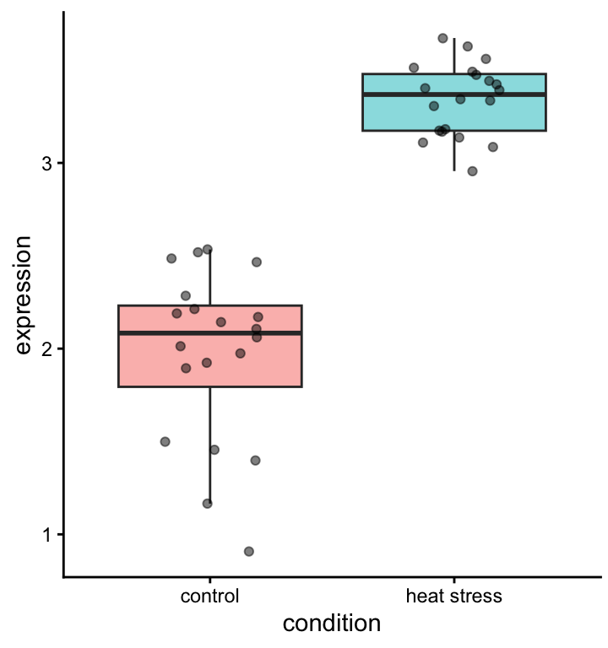
Median: measure of central tendency
Alternative: ?
Quantiles: measure of spread
Alternative: ?

Slide 5
Is this difference significant?
t-test
The power of a statistical test depends on:
The spread in the data
The effect size
The number of replicates

Slide 6
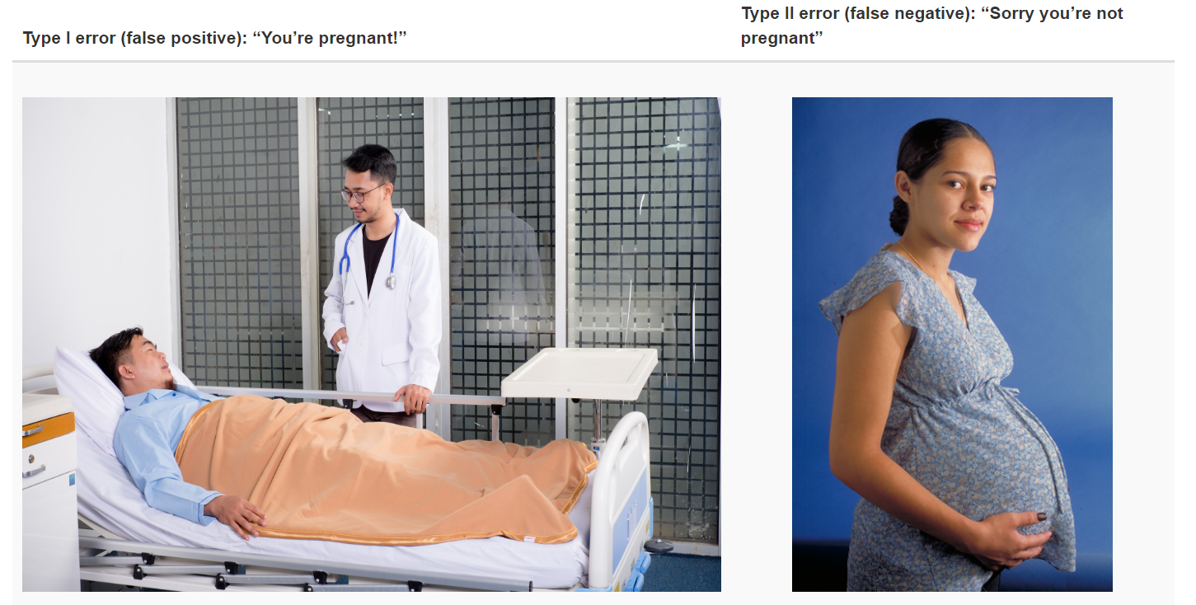
Type I and type II errors

Slide 7
Power analysis for RNA-seq
https://rnaseq-power.serve.scilifelab.se/app/rnaseq-power

Slide 8
Refresher 2: Experimental design
In an RNA-seq experiment, you will measure the expression of 1000s of genes.
Therefore, we need to keep all sources of unwanted variation to a minimum.

Slide 9
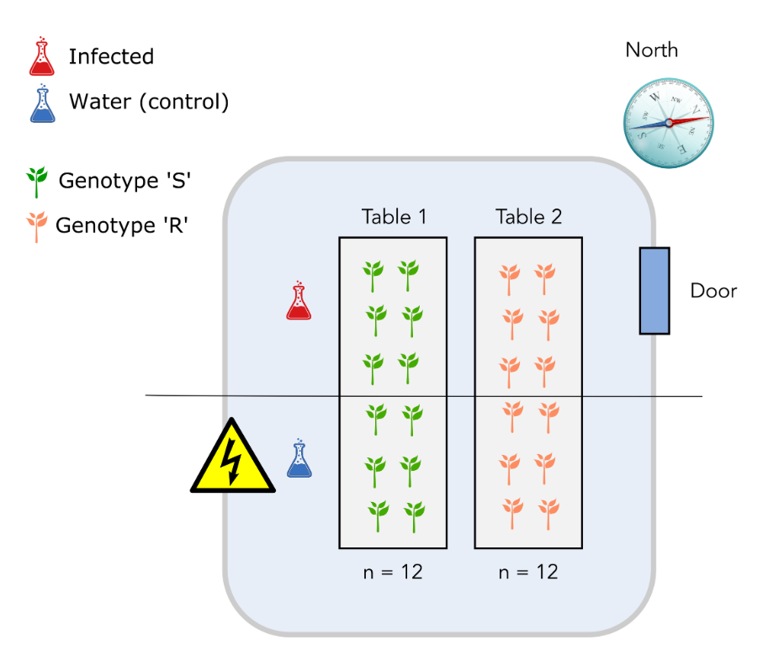
Design 1
Table effect the same as genotype effect!

Slide 10
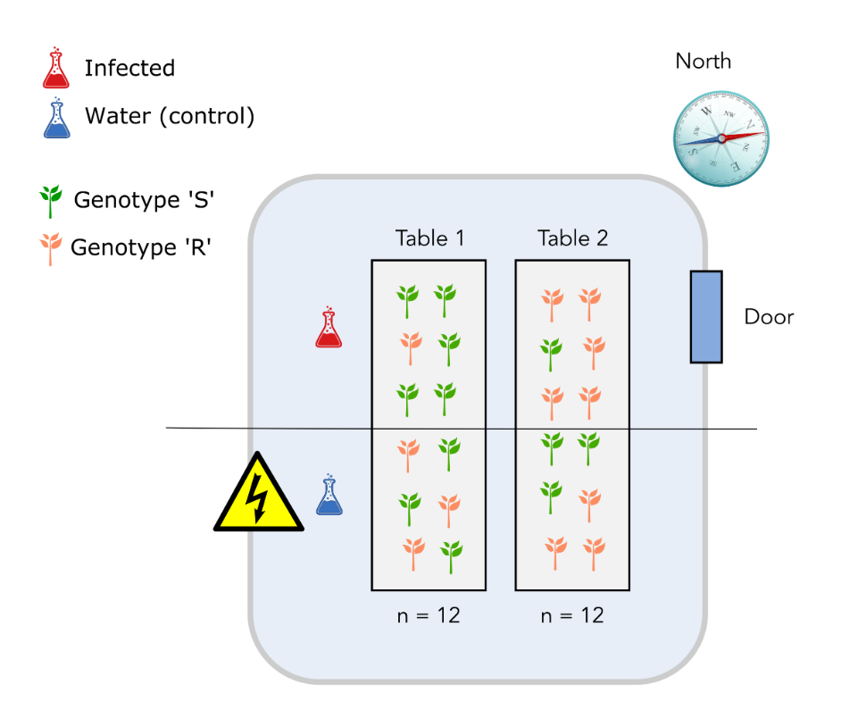
Design 2
'North-south’ effect the same as infection effect!

Slide 11
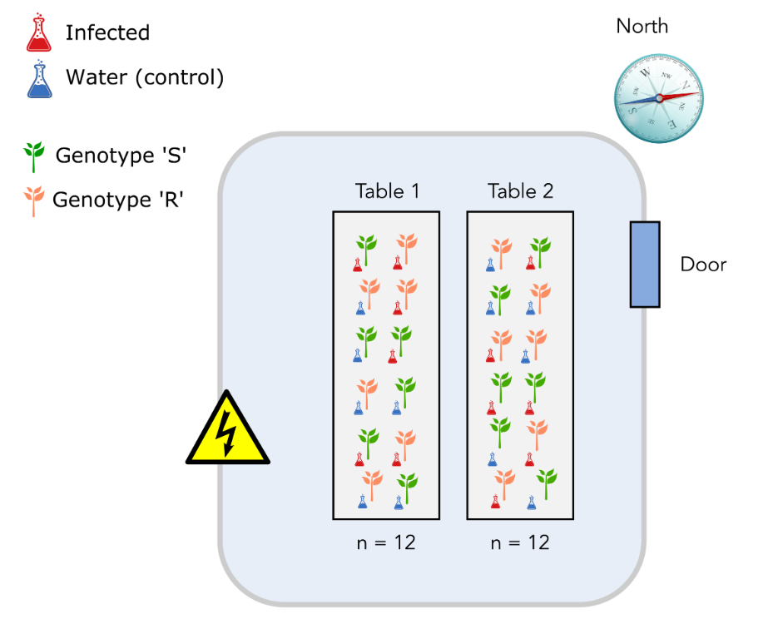
Design 3
Properly randomized design ☺

Slide 12
From sample to reads
Take from Tijs slides:
RNA-isolation
Library prep (super quick)
Sequencing animation
Quality + fastq file layout

Slide 13
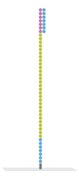

Slide 20
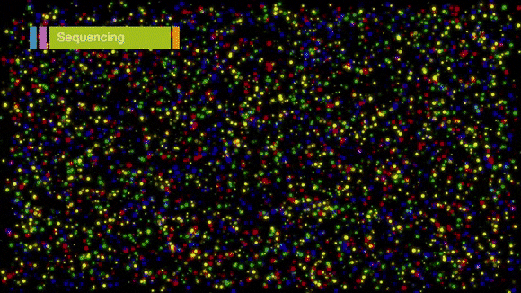
Typically a run consists of 50 to 150 cycles.
> This determines read length

Slide 21
Every sequencing cycle for each spot a base is called and a quality value is given.
(for Illumina, from 0 to 40)

Slide 23
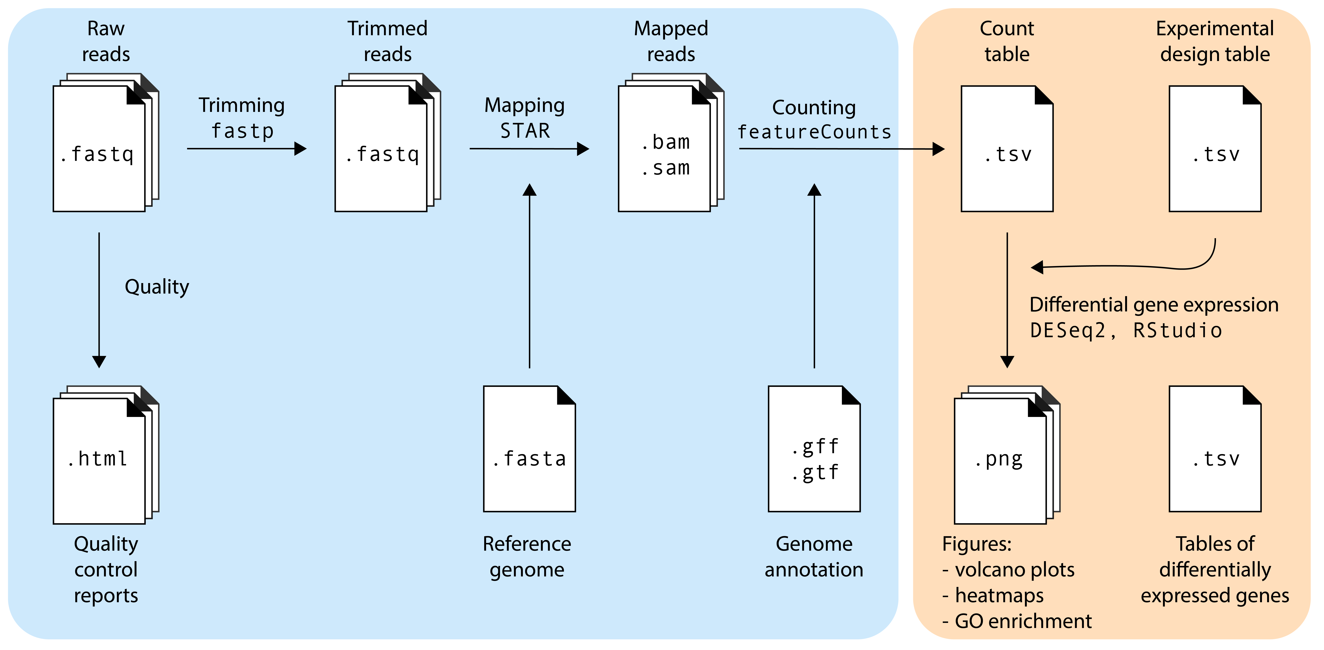
Day 1
Day 2

Slide 24
Workshop logistics
Link to Google colab
Link to hackMD?
Link to materials

